Slide 1
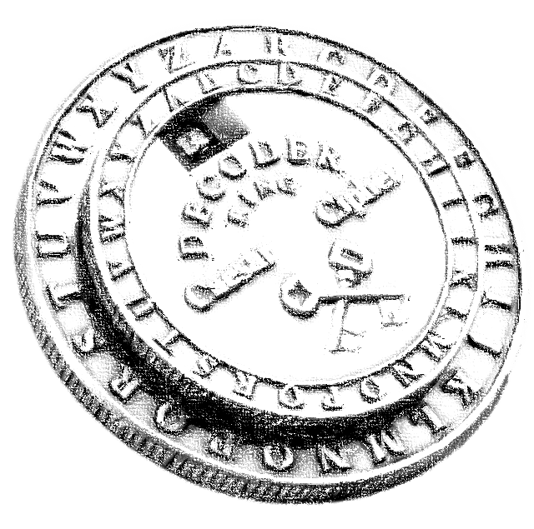
Encryption and Decryption of Text By Using Caesar Cipher.
Vignesh K r​

Slide 2

Agenda
abstract
introduction
Existing method
Architecture diagram
Methodology
implementation
conclusion

Slide 3

ABSTRACT
This project explores the implementation and analysis of the Caesar Cipher in modern cybersecurity, aiming to create a user-friendly software application for message encryption and decryption. Emphasizing efficient algorithmic execution and input validation, it also serves an educational purpose. Security analysis considers vulnerabilities like brute-force attacks and frequency analysis. Various threat scenarios are simulated to underscore the need for supplementary security measures.
The project explores potential cipher enhancements, balancing simplicity and security. Insights into theoretical and practical aspects contribute to understanding the Caesar Cipher's role in contemporary cybersecurity, highlighting educational value and limitations.

Slide 4
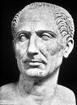
Introduction
The Caesar cipher is a simple encryption technique that was used by Julius Caesar to send secret messages to his allies. It works by shifting the letters in the plaintext message by a certain number of positions, known as the “shift” or “key”.
The Caesar Cipher technique is one of the earliest and simplest methods of encryption technique. It’s simply a type of substitution cipher. The method is apparently named after Julius Caesar, who apparently used it to communicate with his officials.

Slide 5
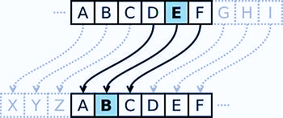
Existing method

Slide 6
Two main method
The method involves shifting each letter of the plaintext by a fixed number of positions in the alphabet. This fixed shift value is known as the key, and it determines the transformation applied to each character. In the standard Caesar Cipher:
1. Encryption: Each letter in the plaintext is shifted forward in the alphabet by the key value. For example, with a key of 3, 'A' becomes 'D', 'B' becomes 'E', and so on.
2. Decryption: To decrypt the ciphertext, the process is reversed. Each letter in the ciphertext is shifted backward by the key value. Using the same key of 3, 'D' becomes 'A', 'E' becomes 'B', and so forth.
It's worth noting that the Caesar Cipher has a key space of 25 (assuming a standard English alphabet), as a key of 0 or 26 would result in the original message, and a key beyond 26 is equivalent to a smaller key due to the cyclical nature of the alphabet. The simplicity of the Caesar Cipher makes it susceptible to brute-force attacks, and its security is considerably limited compared to more advanced encryption methods used in modern cryptography.

Slide 7
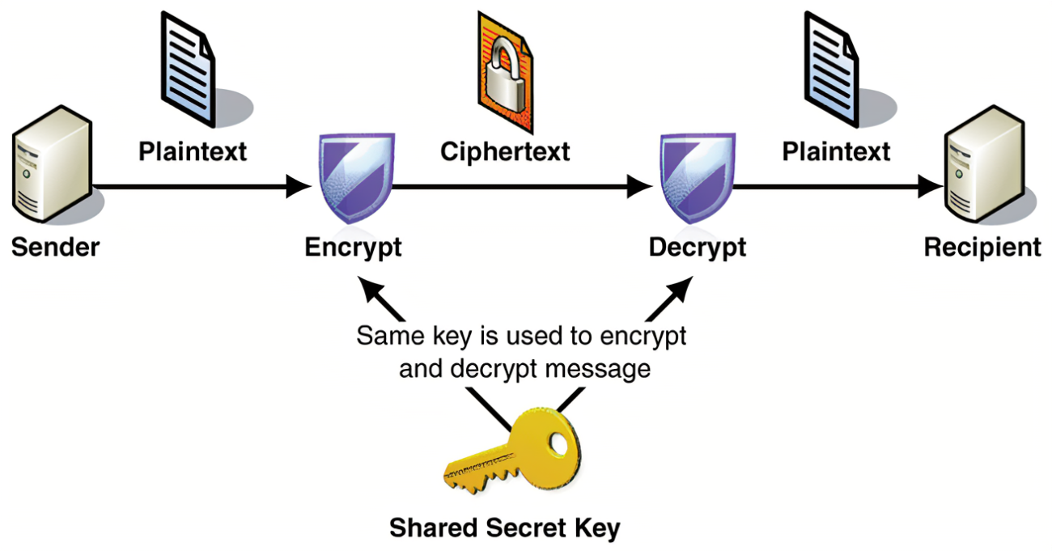
Architecture diagram

Slide 8

methodology

Slide 9





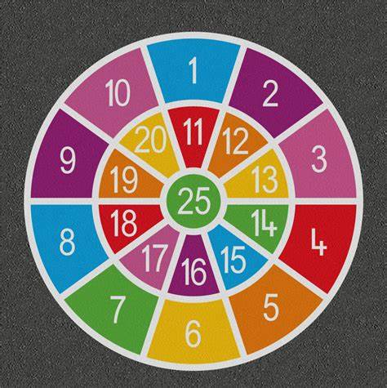


Caesar Cipher involves several key points
Key selection
Alphabetic substitution
Modular arithmetic
Encryption process
Decryption process
Limited key space
vulnerabilities
Historic significance

Slide 10

Timeline
Around 58–50 BCE to 44 BCE:
After 44 BCE:
Late 19th Century to Early 20th Century:
20th Century Onward:
Present Day:
The Caesar Cipher's usage becomes less prominent in historical records.
The Caesar Cipher is occasionally used in puzzle games, educational settings, and as a historical example, but it is not considered secure for practical cryptographic applications.
The Caesar Cipher is believed to have been used by Julius Caesar for military communications during his campaigns.
The Caesar Cipher is frequently used as an introductory example in cryptography courses due to its simplicity.
Revival of interest in historical ciphers, including the Caesar Cipher, with the development of cryptography as a formal field of study.

Slide 11
IMPLEMENTATION
Implementing the Caesar Cipher involves creating algorithms for both encryption and decryption
SOFTWARE REQUIREMENT:
SOFTWARE: Apache NetBeans IDE
LANGUAGE: Java
OPERATING SYSTEM : Windows 10
In this Java Implementation:
The cenc.java file shifts each alphabetic character in the plaintext by the specified shift value.
The cdec.java utilizes the cenc.java with a negative shift value to reverse the process.

Slide 12
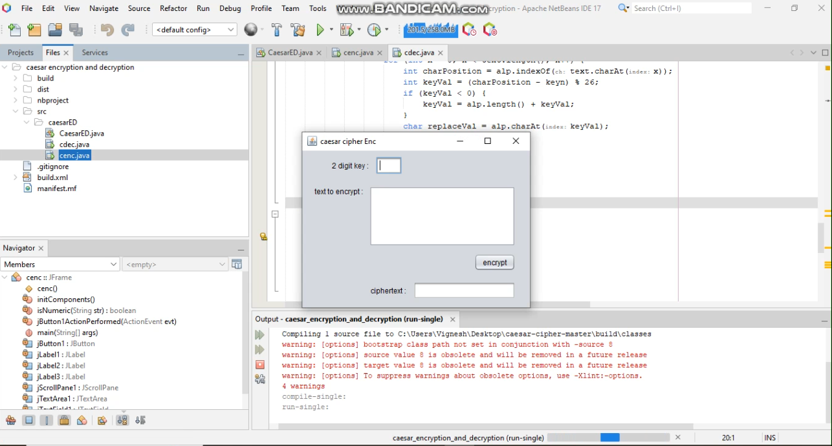
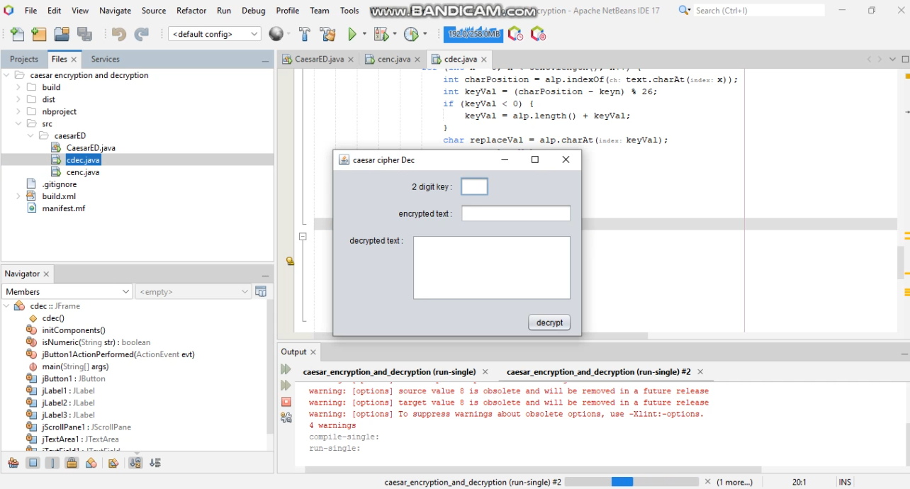
Non - alphabetic characters are preserved in both encryption and decryption.
Implementation usage demonstrates encrypting and decrypting a simple message with a shift value of 3.

Slide 13
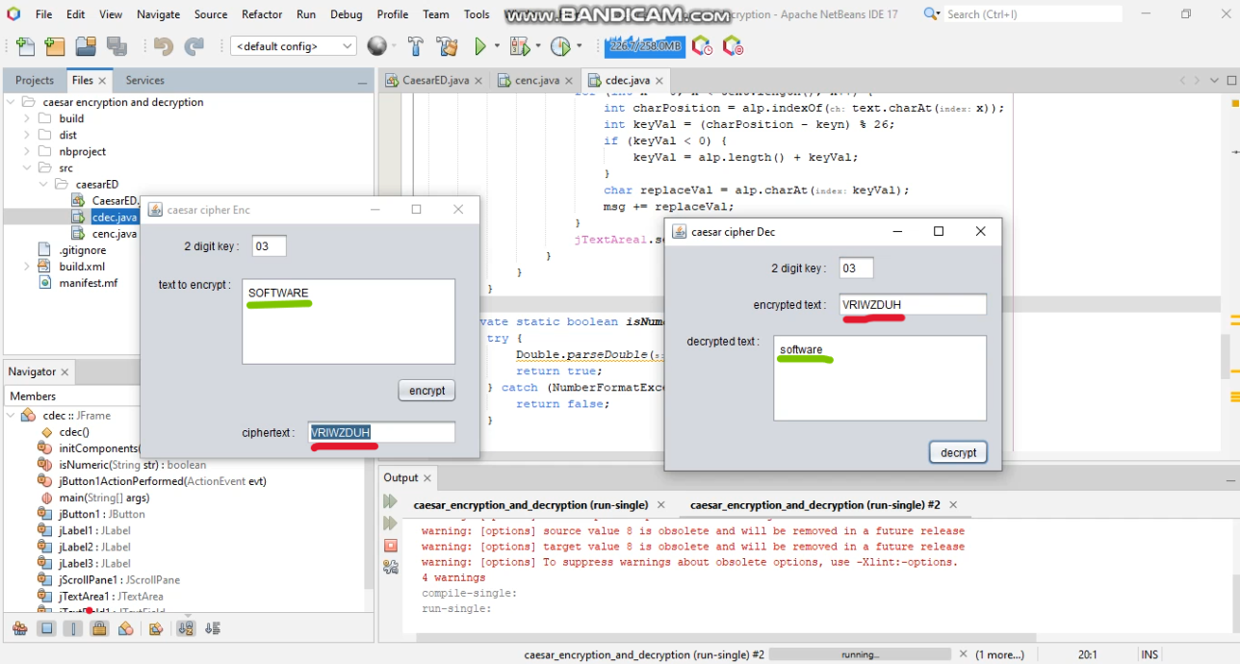
Remember that this is a basic implementation for educational purposes. In real-world applications, more advanced encryption algorithms with larger key spaces are recommended for security.

Slide 14
Key benefits of proposed environment
Apache net beans
java
Integrated Development Environment (IDE):
Apache NetBeans is a free, open-source IDE that supports the development of Java, HTML, JavaScript, PHP, and other languages.
Modular Architecture:
NetBeans follows a modular architecture, allowing developers to extend its functionality with plugins.
Code Editing and Refactoring:
Offers intelligent code editing features and supports various code refactoring operations to enhance code quality.
Build and Deployment Tools:
Built-in tools for building, testing, and deploying applications, simplifying the development lifecycle.
Cross-Platform Compatibility:
Available for multiple operating systems, including Windows, macOS, and Linux.
Object-Oriented:
Java is a strictly object-oriented programming language, emphasizing the use of classes and objects in software development.
Platform-Independent:
Java programs can run on any device with the Java Virtual Machine (JVM), providing platform independence.
Write Once, Run Anywhere (WORA):
The principle that code written in Java can be executed on any platform without modification.
Rich Standard Library:
Java comes with a comprehensive standard library, offering a wide range of classes and methods for various tasks.
Multithreading Support:
Built-in support for multithreading, allowing the concurrent execution of multiple threads for better performance.

Slide 15
conclusion
Through the implementation of software applications, educational tools, and thorough security analyses, the project aimed to showcase the strengths, weaknesses, and educational value of the Caesar Cipher.
The simplicity of the Caesar Cipher, while historically significant, has been underscored by its vulnerability to brute-force attacks due to its limited key space. The project successfully demonstrated the encryption and decryption processes, shedding light on the algorithm's straightforward architecture. Moreover, the security analysis simulated potential threats, emphasizing the importance of combining the Caesar Cipher with additional security measures in practical applications.
In conclusion, this project has contributed to a nuanced understanding of the Caesar Cipher's role, limitations, and educational significance in the evolving landscape of information security and cryptography. While not suitable for high-security applications, the Caesar Cipher remains a valuable tool for educational purposes and historical exploration.

Slide 16
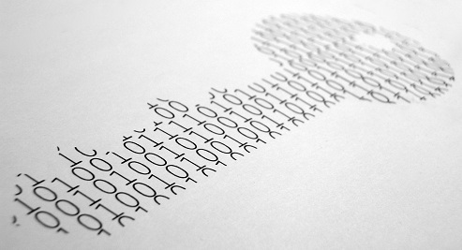
Summary
The Caesar Cipher project develops a user-friendly software application for message encryption and decryption, emphasizing algorithmic efficiency, security analysis, and educational value. Simulating threat scenarios, it underscores the need for additional security measures. Exploring enhancements, the project seeks a balance between simplicity and security, contributing to understanding the Caesar Cipher's role in contemporary cybersecurity.

Slide 17
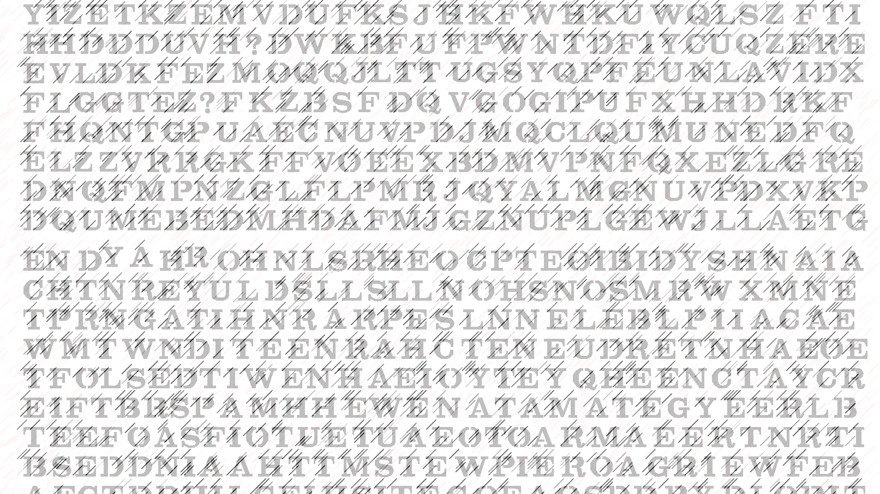
Thank you

